Slide 1
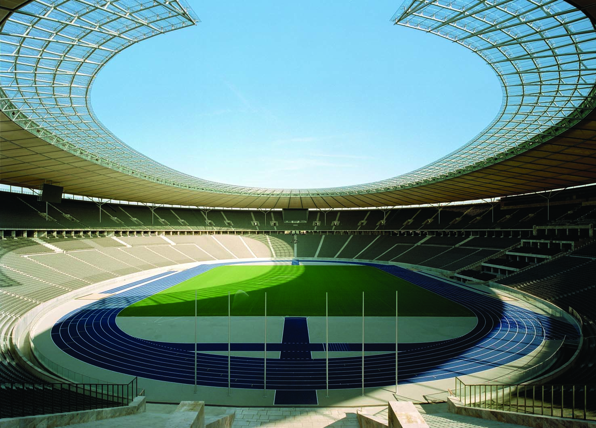
9
THE REAL ECONOMY IN THE LONG RUN

Slide 2
25
Production and Growth

Slide 3

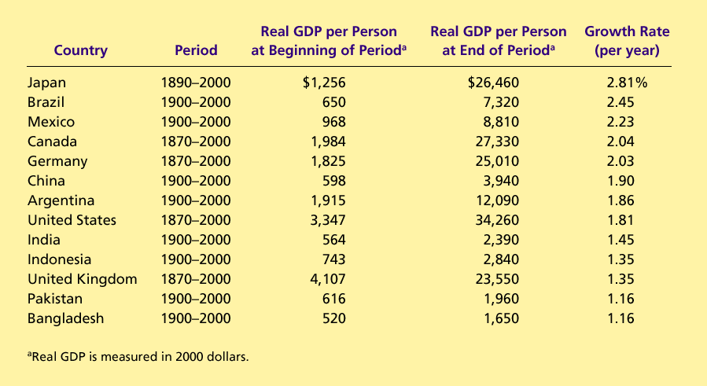
Table 1 The Variety of Growth Experiences
Copyright©2004 South-Western

Slide 4

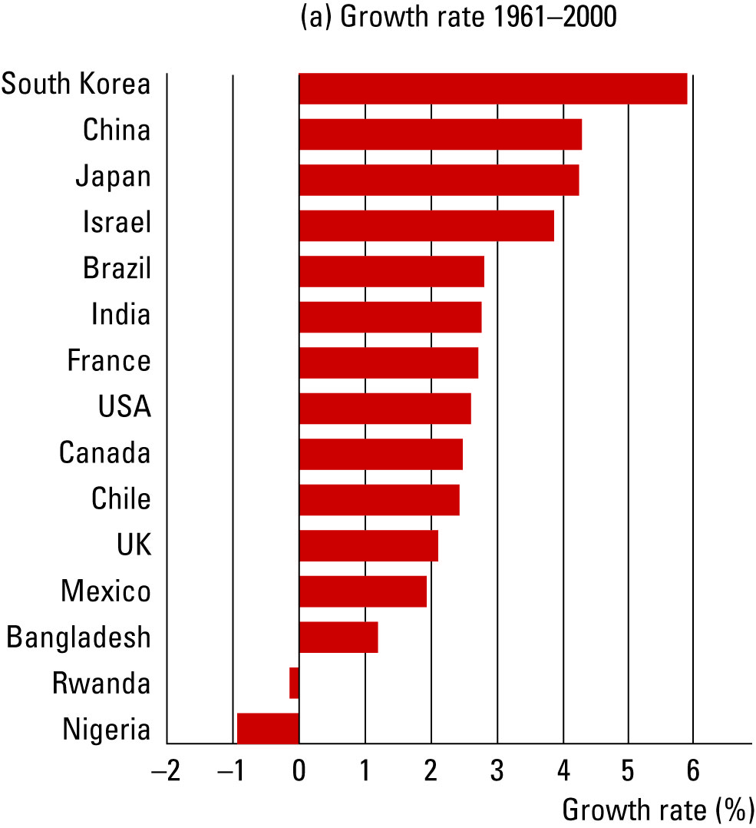
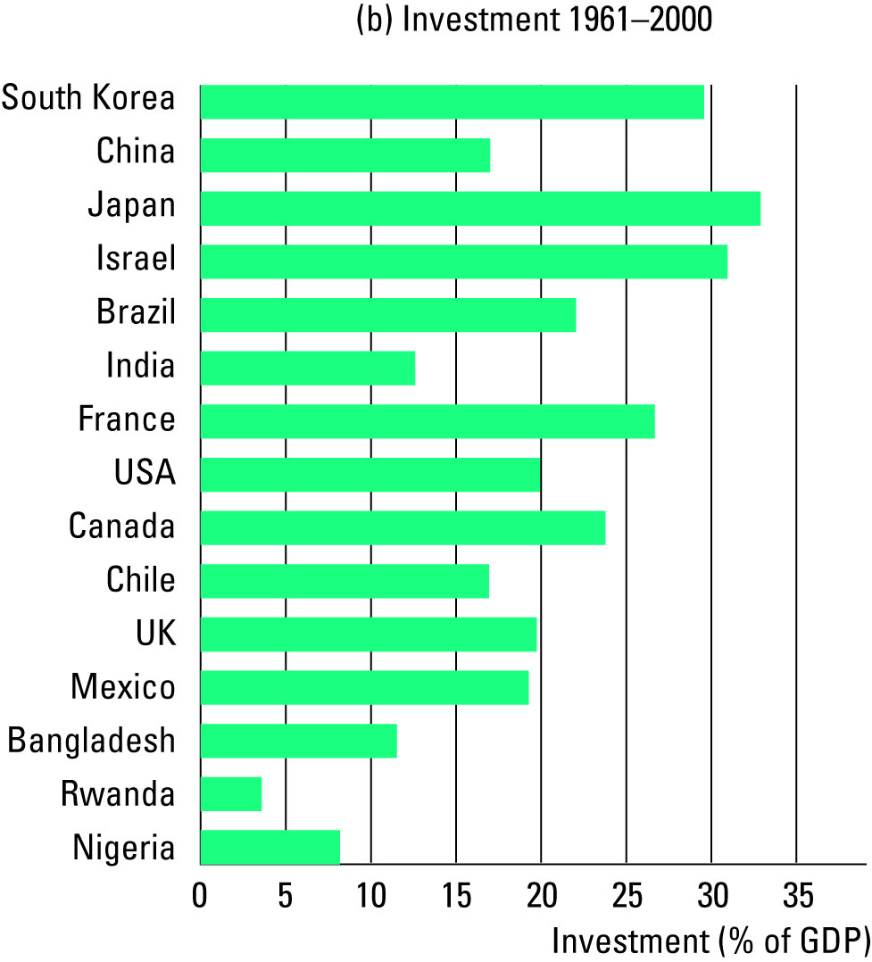
Figure 1 Growth and Investment
Copyright©2003 Southwestern/Thomson Learning

